Slide 1

Selenium IDE Commands

Slide 2
Commands
Open-Opens the specified URL
click or clickAndWait- Clicks on a desired element.
verifyTitle/assertTitle- Compares the actual page title with an expected value.
waitForPageToLoad- Pauses execution until the page is loaded completely.
Select- selecting options from a drop-down listbox
Type-to enter the values

Slide 3
Assertions
Assertions are common part of testing
They are used to check if
an element is present somewhere on the page?
specific text is somewhere on the page?
specific text is at a specific location on the page?
There are multiple assertions to perform verification and validation

Slide 4
Adding Assertions
The steps for inserting the assertions are as follows:
While recording Right Click → Show all commands → select an assertion

Slide 5
Assertion Commands
assertTextPresent
This will assert if the text is present in the page.
assertText
This will assert if a particular element is having the particular text.
assertTitle
This will assert if the page is having a proper title.
assertValue
This will assert if a Text box or check box has a particular value
assertElementPresent
This will assert if a particular UI Element is present in the page

Slide 6
Verification Commands
verifyTextPresent
This command is used to check if a particular text is present in a page or not.
To add this command , While recording the test steps right click on the text item that you want verify. Once right clicked you can find an option “Show all commands”. On Clicking it you will find an option “verifyTextPresent”, select it.

Slide 7
Verification Commands-2
verifyValue
This method is used to check if edit box has particular value or if the check box is on. Basically this method returns the value of present in the object.
To add this command , While recording the test steps right click any element on the page that you want verify the value of. Once right clicked you can find an option “Show all commands”. On Clicking it you will find an option “verifyValue”, select it.

Slide 8
Verification Commands-3
verifyElementPresent
This command is used to verify if a page element is present in the page or not.
To add this command , While recording the test steps right click any element on the page that you want verify. Once right clicked you can find an option “Show all commands”. On Clicking it you will find an option “verifyElementPresent”, select it

Slide 9
Wait Commands
waitForPageToLoad- make the script to wait till the page loads.
waitForAlert-wait for the alert message to appear
waitForTitle- will for the page Title to appear on the browser.
waitForTable-wait for the Web table to completely load in the page

Slide 10
Handling Store Commands
Used to fetch the values from the application and store it in a variable.
These variables can be used latter for validation purpose.
Used to retrieve the page title, text from the page and other attributes from the application

Slide 11
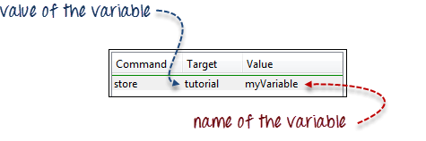
Store Command Example
1

Slide 12
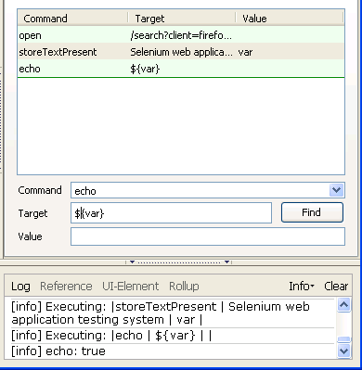
Echo Commands
Echo command is used to print the value in to the selenium IDS log.
When printing a variable use ${var}

Slide 13
Thanks

